Slide 1
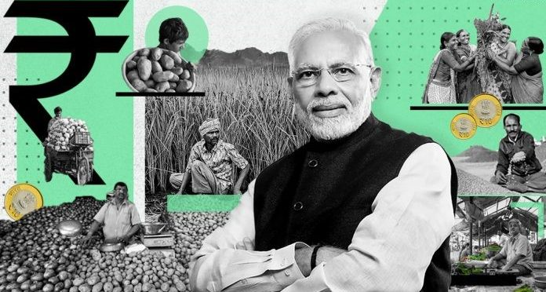
FARM BILL 2020
BY IIOT B1 AVISHISHT GUPTA, KUNAL RAWAT, ANKIT TAYAL, KSHYMAK
BY AVANISH GUPTA, KUNAL RAWAT, ANIKET TAYAL,KSHYMAK
00419011721, 01419011721, 04319011721, 05919011721

Slide 2
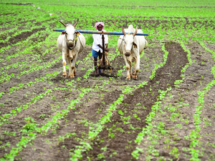
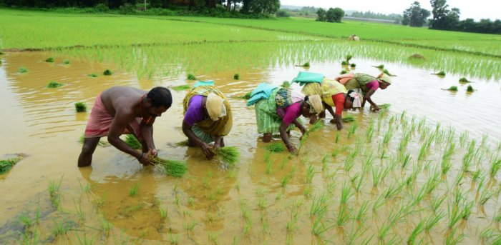
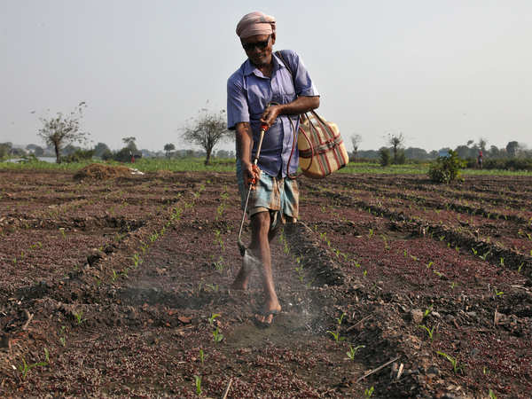
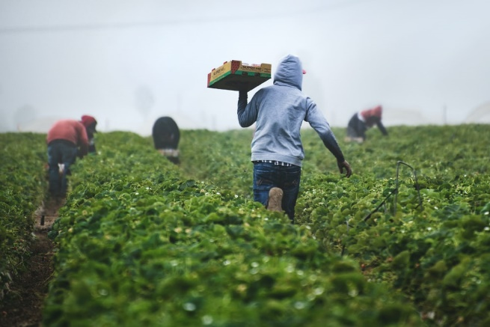
History of agriculture in india
The share of agriculture in GDP increased to 19.9 per cent in 2020-21 from 17.8 per cent in 2019-20. The last time the contribution of the agriculture sector in GDP was at 20 per cent was in 2003-04
Agriculture is the primary source of livelihood for about 58% of India’s population
India is the world's largest producer of milk, pulses and jute, and ranks as the second largest producer of rice, wheat, sugarcane, groundnut, vegetables, fruit and cotton

Slide 3
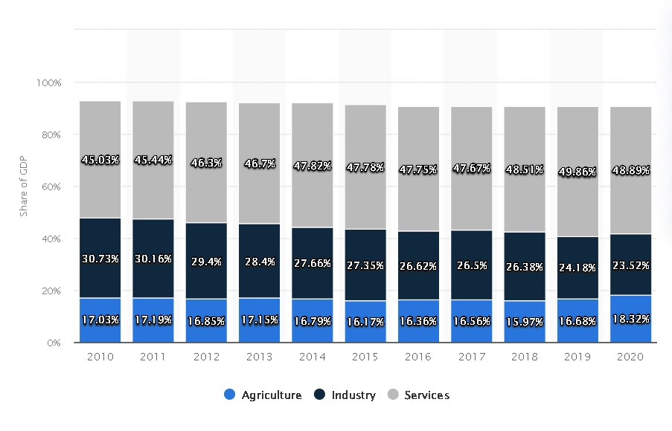
For a detailed report you can visit at
https://www.indiabudget.gov.in/economicsurvey/doc/Statistical-Appendix-in-English.pdf

Slide 4
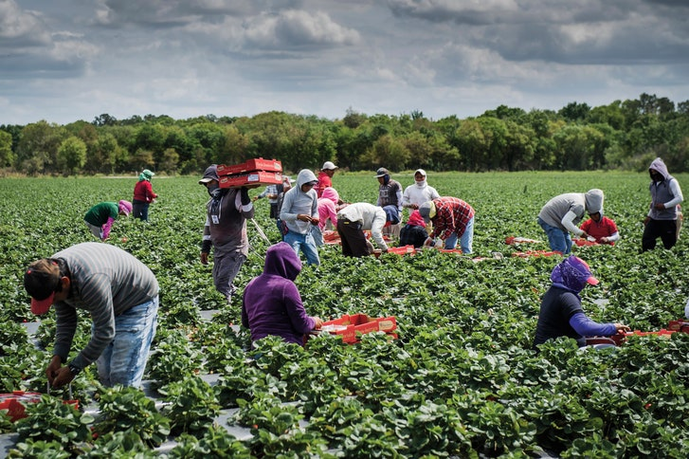
MAJOR PROBLEMS FACED BY THE FARMING
SECTOR
Lack of Organized Marketing System
Too Many Intermediates
Lack of Standardization
Corrupt Policies
illiteracy and Lack of Unity among Farmers
Lack of a proper marketing channel forces
Lack of availability of financial resources
Lack of awareness about market

Slide 5
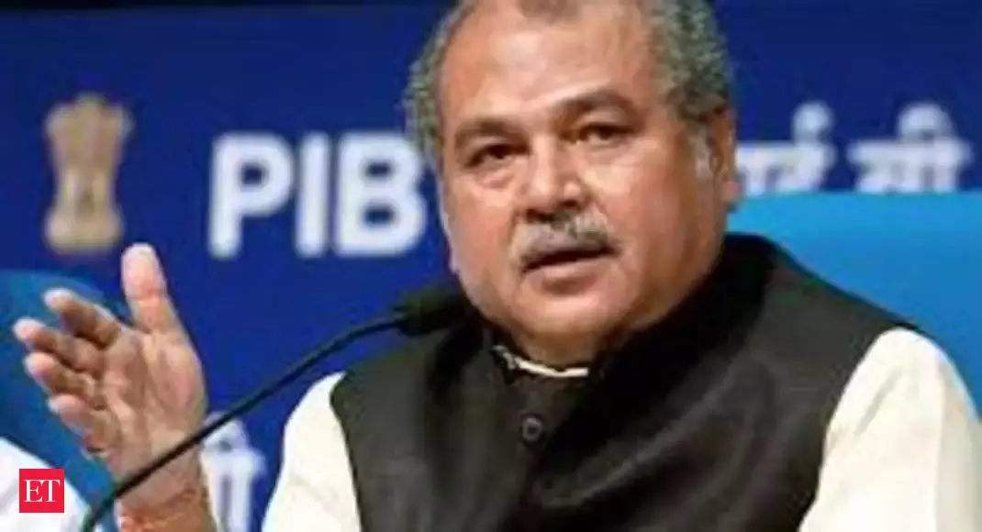
THE FARMERS PRODUCE TRADE AND
COMMERCE (PROMOTION AND FACILITATION)
BILL 2020
Permits intro-state and inter-state trade of farmers’ produce
Freedom of choice
Efficient, transparent and barrier-free
Facilitate framework for electronic trading
agriculture minister
Narendra Singh Tomar

Slide 6
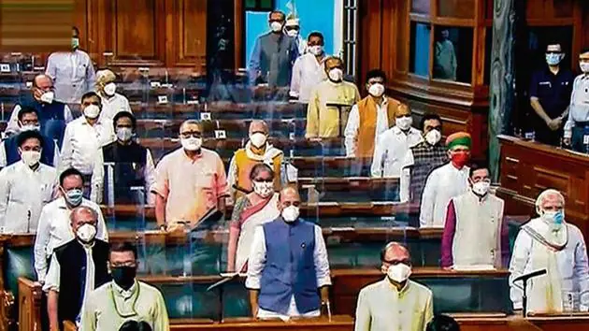
THE FARMERS (EMPOWERMENT AND PROTECTION )
AGREEMENT ON PRICE ASSURANCE AND FARMERS
SERVICE BILL 2020
Protection of farmers interest
Contract farming
Nation wide legal framework
Corporate Dominance
No Exploitation of Farmers

Slide 7
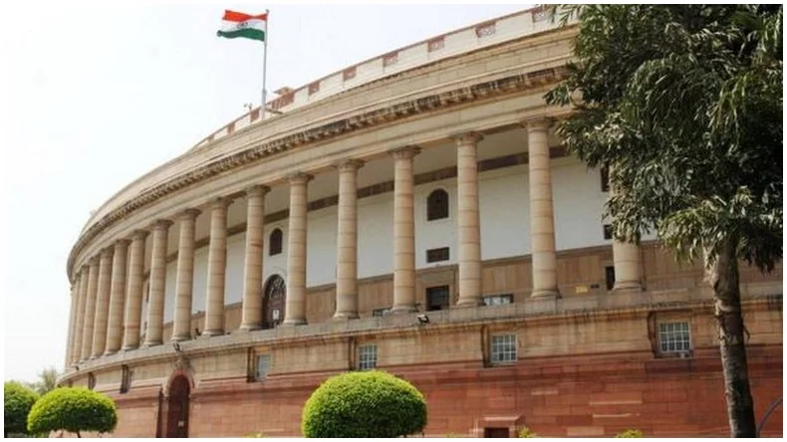
THE ESSENTIAL COMMODITY(AMENDMENT) BILL, 2020
ADD/REMOVE ESSENTIAL COMMODITIES BOOSTING FARMERS INCOME
50% INCREASE IN NON PERISHABLE ITEMS 100% FOR PERISHABLE ITEMS
BLACK MARKETING
MONOPOLY OF PRIVATE COMANY

Slide 8
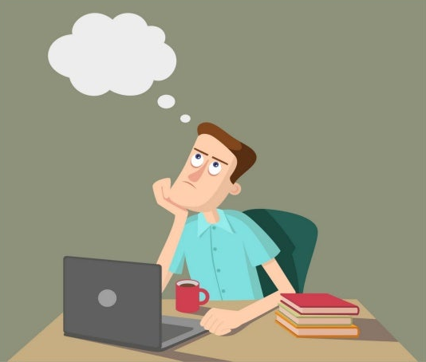
WHAT COULD BE NEXT
Facilitating the crops to common public
Public investments for agriculture
Giving them more information and insights in much clearer way
Produce more and control cost by low cost and efficient farming modals and

Slide 9
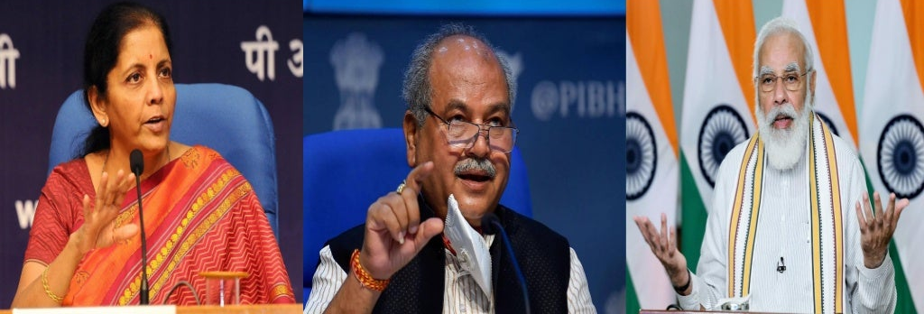
PROVISIONS

Slide 10
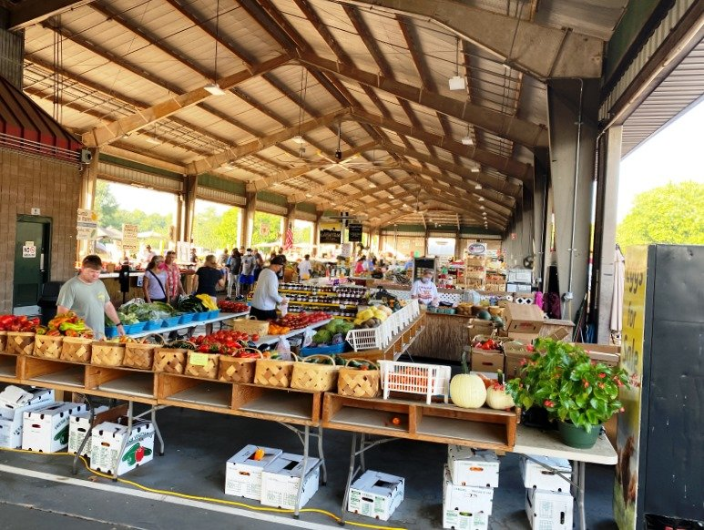
Bill on Agri market
Farmers Produce Trade and Commerce(Promotion and Facilitation) Bill, 2020
Independence to the agricultural sector
Farmers are now more free to sell their products
To promote inter-state and intra-state trade
To reduce marketing/ transportation costs
Electronic trading(e-NAMI/transform the agriculture sector
One Nation-One Market

Slide 11
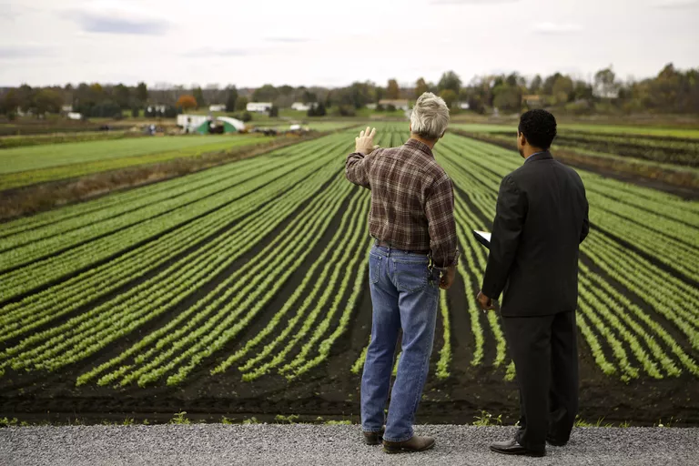
Bill on contract farming
The Farmer (Empowerment and Protection) Agreement of Price Assurance and Farm Services Bill, 2020
Farmers can enter into a direct contract with business firms agribusiness firms and to the global
Marginal and small farmers, with land less than five hectares, to gain via aggregation and contract
To transfer the risk of market unpredictability from farmers to sponsors
To enable farmers to access modem tech
reduce cost of marketing and boost farmer's income
Farmers can engage in direct marketing
Effective dispute resolution mechanism

Slide 12
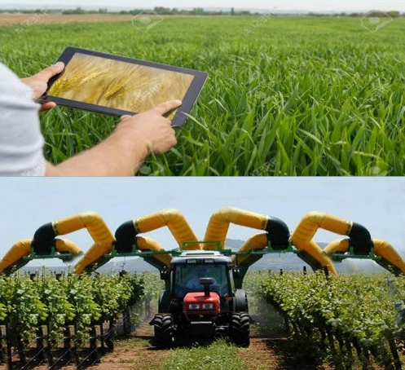
Bill relating to commodities
The Essential Commodities (Amendment) Bill, 2020
This Bill will replace all essential commodities
Attract private sector/ attracting FDl
Bring investment for farm infrastructure and modernizing food supply chain.
Help both farmers and consumers by bringing in price stability.
Less wastage of farm produce.
The Minimum Support Price (MSP)

Slide 13
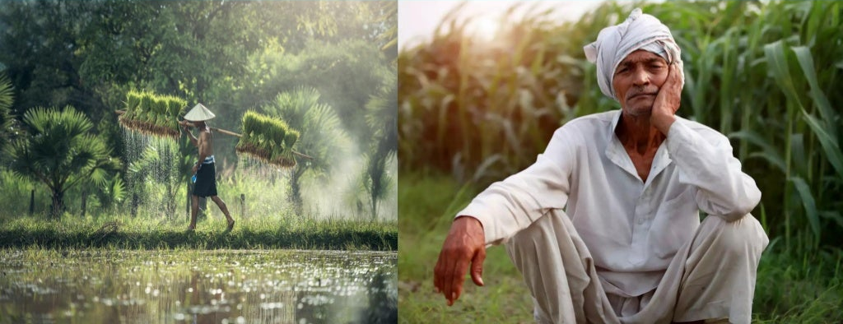
DRAWBACK OF FARM BILL 2020

Slide 14
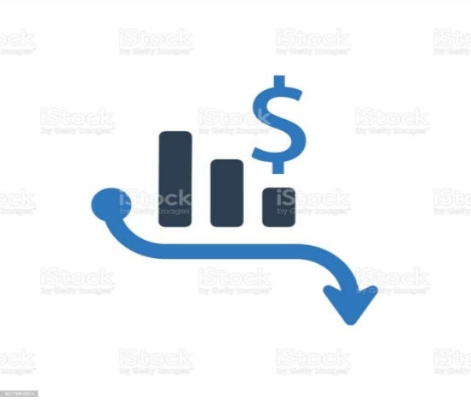
Bill on contract farming
State will lose revenue
Effects commission agenm.
Prone to fraud

Slide 15
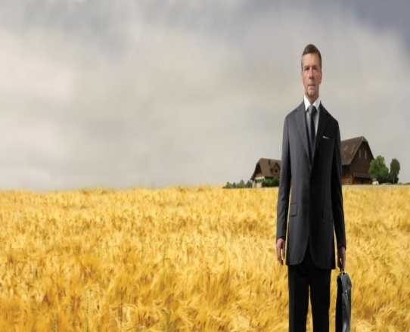
Empowerment and Protection Bill 2020
Determining price.
Difficulty for sponsors to make deal with small and marginal farmers
Private corporate house lead to former exploitation.
Exploited by the Sponsors
Subsistence Crop will be broken.
Disputes arising

Slide 16
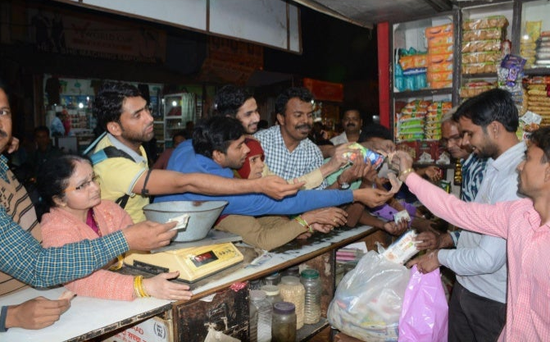
Amendment Bill 2020
Monopoly in the market.
Black Marketing and Harding.
Less income for cultivators

Slide 17
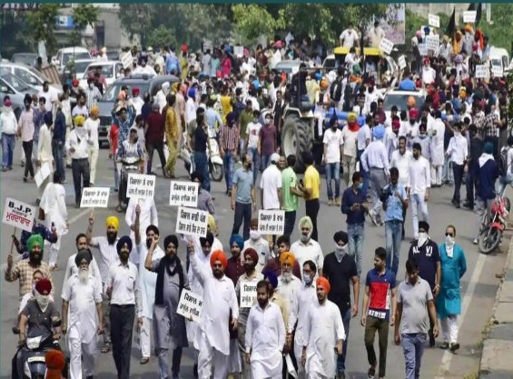
WHO ARE PROTESTING
Protests started in the north Indian states when the ordinances were introduced in Parliament and passed via voice vote in the Lok Sabha and Rajya Sabha.
The bills was opposed in both houses by opposition names including TMC,CO RESS, D K and BSP.
Farmers started protesting in many parts of North India, especially Punjab and Haryana. A tractor was set on fire of India Gate.
A massive protest is also raging across Karnataka where a state-Wide bandh was observed.
There were protests outside 250 Central govt. offices in Kerala.

Slide 18
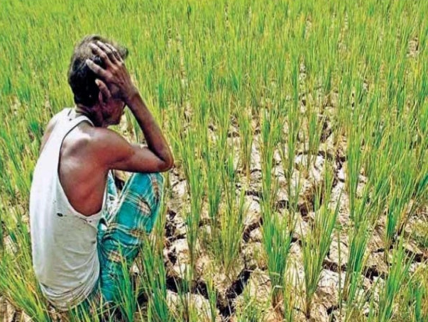
WHAT ARE THE FARMERS CONCERNS
To protect mandis market
New law for the regulation of MSP
Against the corporatization of agriculture .
Free market V/S Regulated market

Slide 19
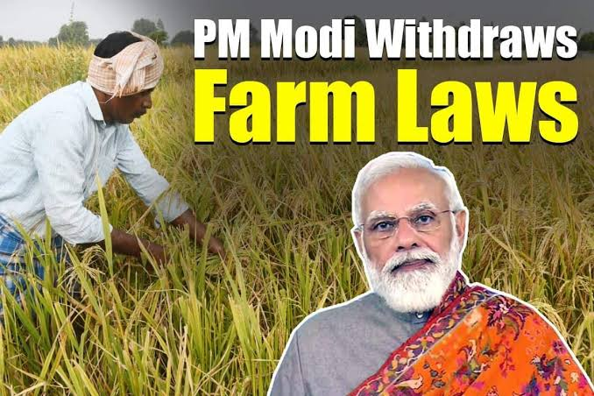
Farm laws repealed
The government got the Farm Laws Repeal Bill, 2021, passed in both Houses of Parliament on Monday the first day of the winter session without any discussion, depriving the opposition any opportunity to speak on the contentious laws that had triggered protests more than a year ago

Slide 20
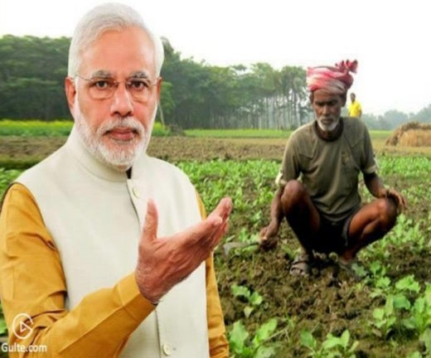
CONCLUSION
The farmers are the soul of our nation and their growth and upliftment IS the foremost duty to be taken care of by the government.
Farmers will be freed from the clutches of selling their produce at designated places.
However this contracts also include the dangers of turning farmers Into slaves.
Moreover, the main thing to do ensure the betterment of farmers is strengthening the government market spaces- APMCs and to eliminate the loopholes in them.
In public interest farm laws were repealed.

Slide 21
Thank You
For more information here are links of informational videos and article
https://www.youtube.com/watch?v=oQlicIzQork
https://www.youtube.com/watch?v=Mist4zw3e3I
https://www.pib.gov.in/PressReleasePage.aspx?PRID=1741942

